Slide 1



X
Logo Company
Create Data Warehouse using Microsoft SQL and ETL job using Talend
Virtual Internship Experience
Presented by
Muh Sanvi Fahrudin

Slide 2







Muh Sanvi Fahrudin
Job Experience
Muh Sanvi Fahrudin
Contract (Des 2021 – Feb 2023)
Muh Sanvi Fahrudin
As a recent graduate from a data engineering bootcamp, I have gained a strong understanding of essential data engineering tools such as Airflow, Python, PostgreSQL, Hadoop, ETL processes, Spark, Machine Learning, Kafka streaming data, BI tools, Docker, Github and data warehousing. Although I lack professional experience in the field, I have a solid educational foundation and have completed a one-month internship as a data engineer at a Bank. My academic background includes a degree in physics, which has given me a deep understanding of mathematical concepts and data analysis. I also have one year of experience working in quality control at an automotive company, where I honed my attention to detail and analytical skills.
Quality Control in Automotive
Manufacture Company
Virtual internship (Jan 2023)
Data Engineer
Virtual internship (Mar 2023)
Big Data Analyst

Slide 3
Case Study

Slide 4
One of the clients from ID/X Partners engaged in the field e-commerce has a need to create a Data Warehouse that comes from several tables from the source database. This Data Warehouse will later consist of one Fact table and multiple Dimension tables.
As a Data Engineer, there are several tasks that you need to do that is :
1. Perform Import/Restore Database Staging.
2. Create a Database named DWH_Project, as well create Fact and Dimension Tables from existing tables in staging database.
3. Create an ETL Job in the talend application to move data from Staging to Data Warehouse. Especially for Tables DimCustomer, perform data transformation by changing data from the FirstName and LastName columns to capital letters all, then concatenate the two columns into one column named CustomerName.
4. Create a Store Procedure (SP) to display summary sales order based on delivery status.

Slide 5
Insert Your Result Here

Slide 6
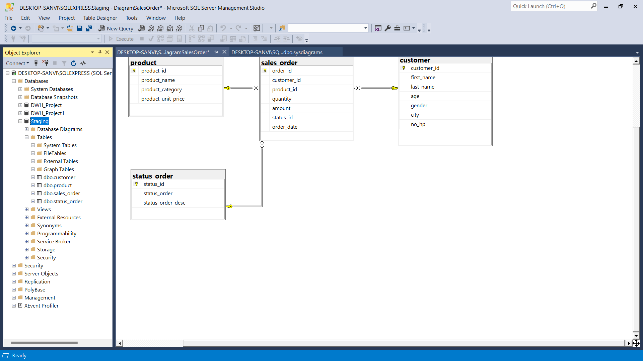
1) Perform Import/Restore Database Staging.

Slide 7
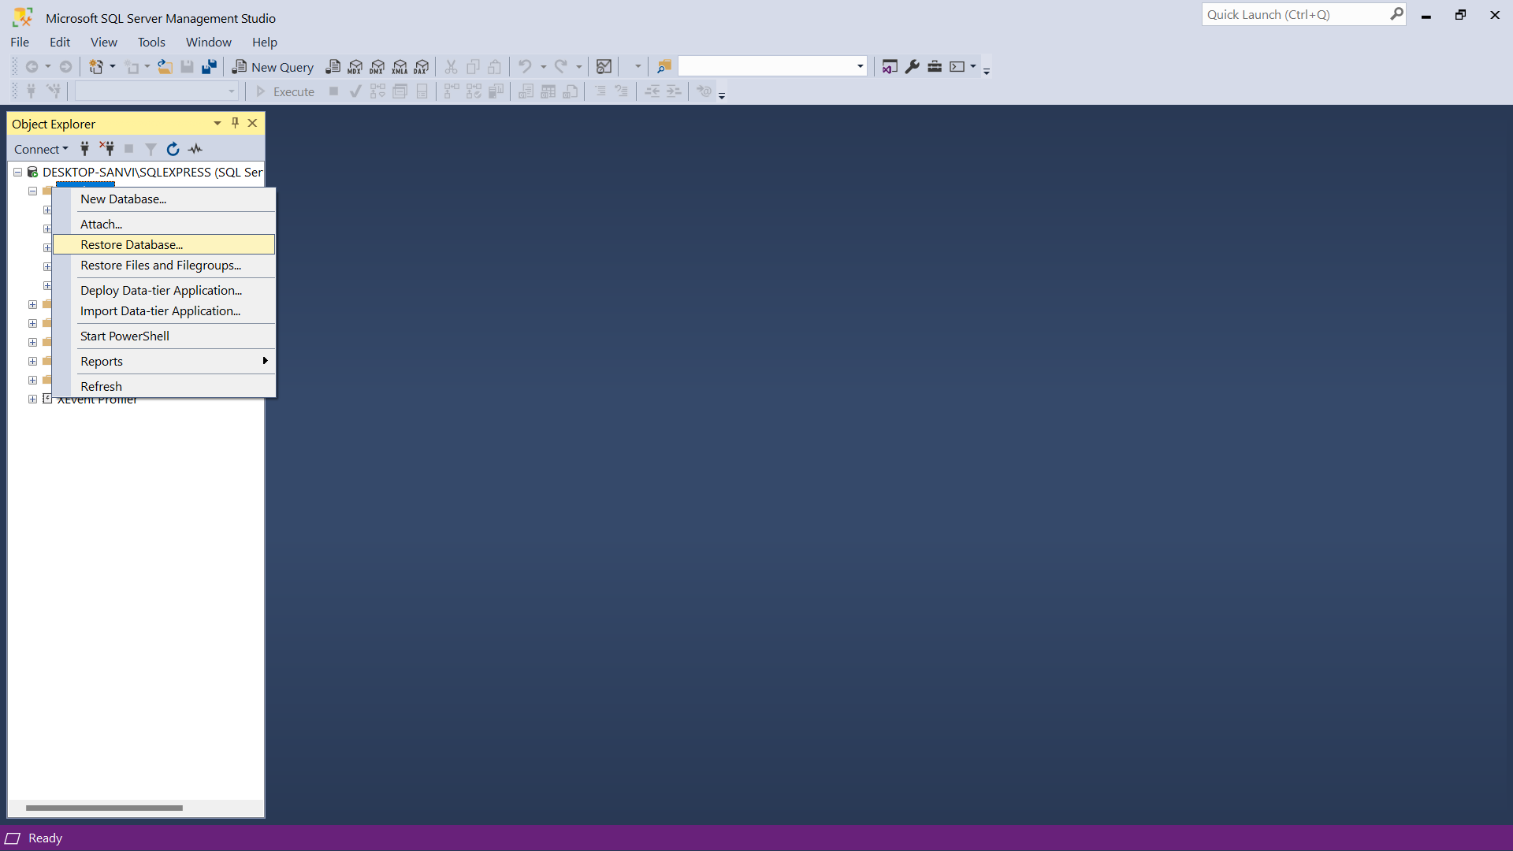
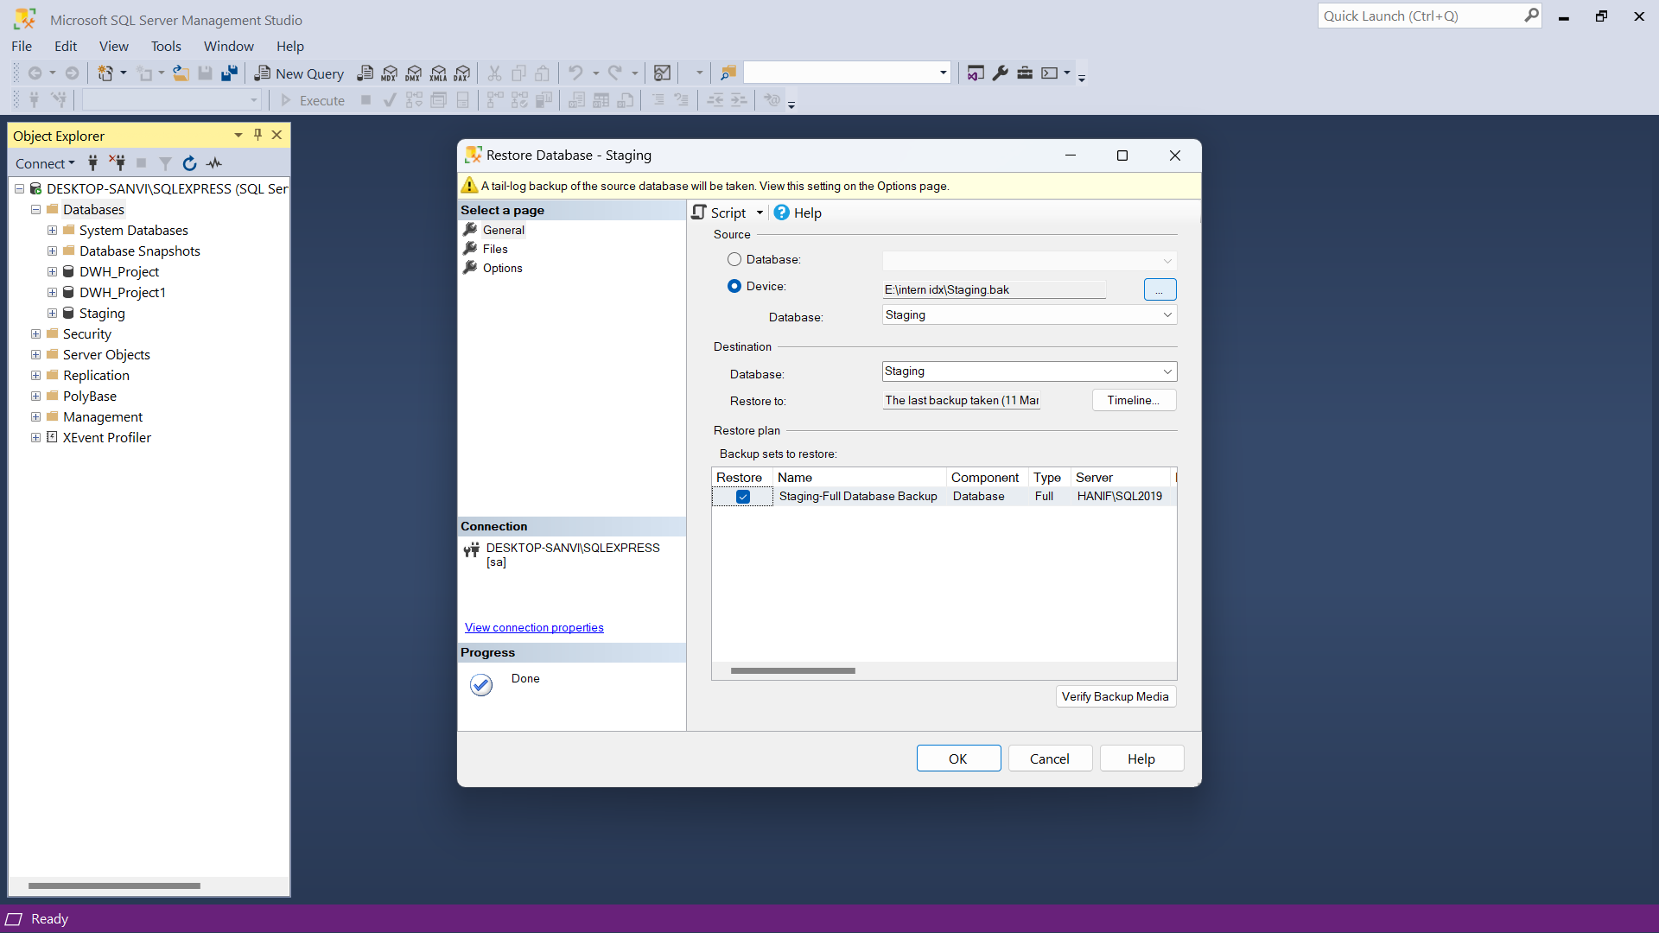
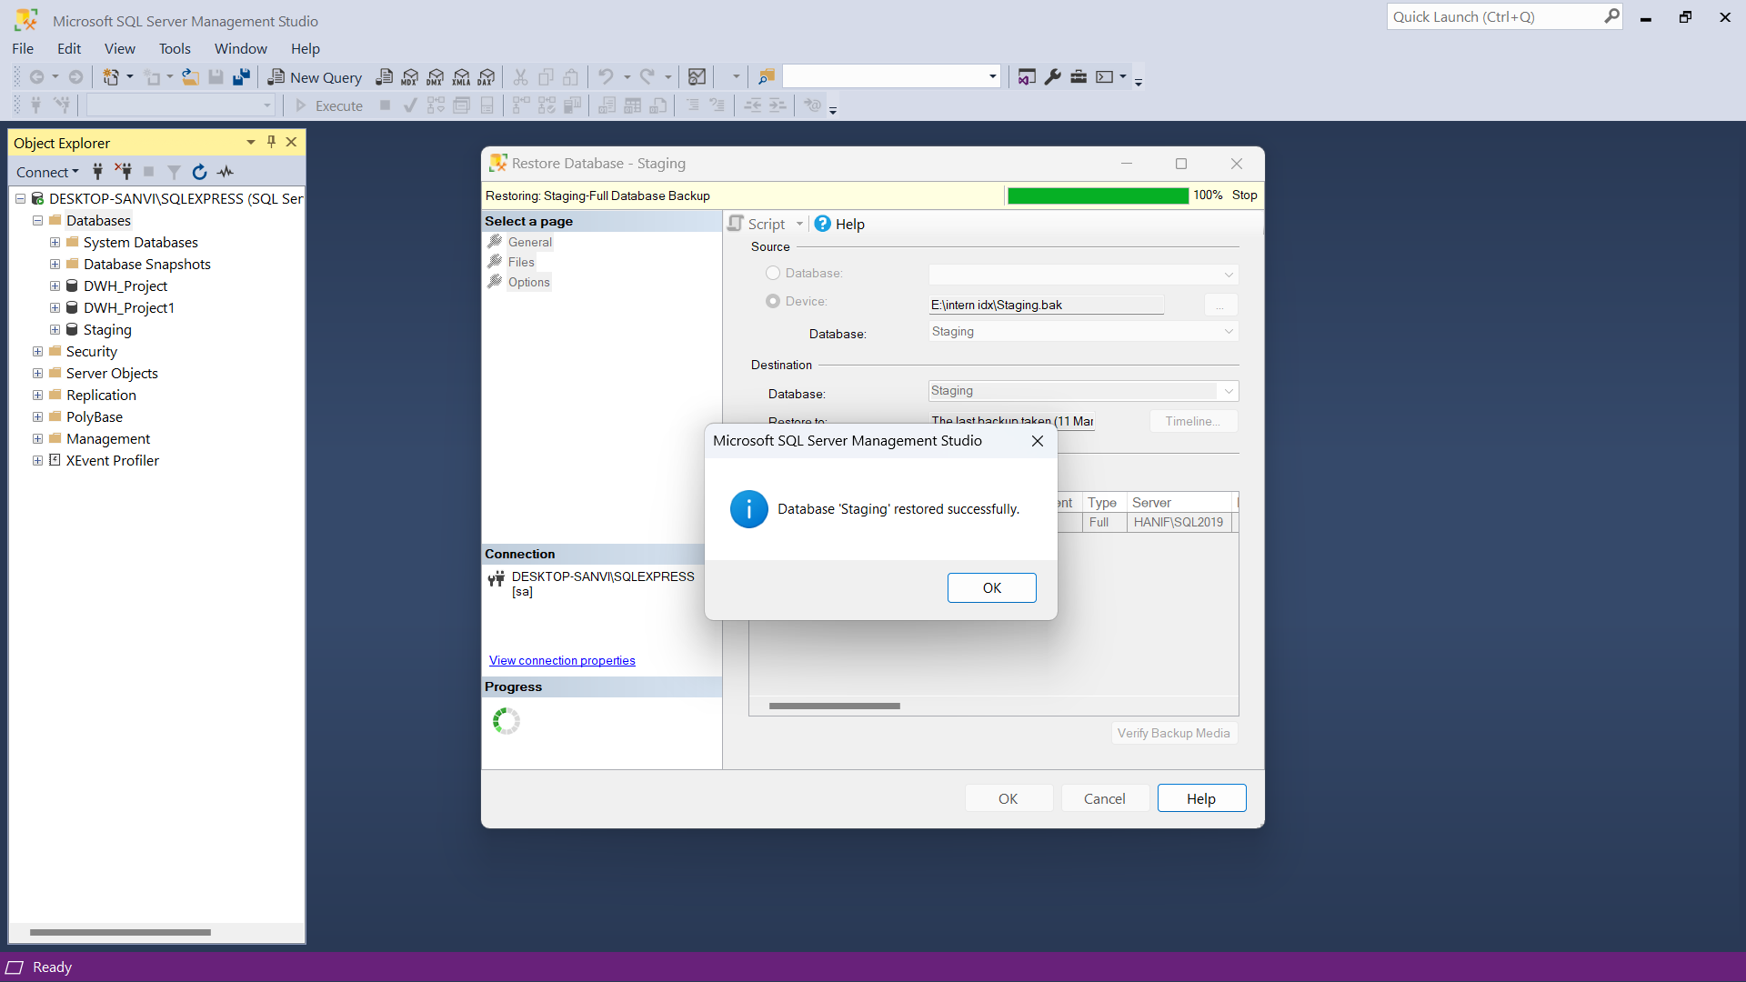
1) Perform Import/Restore Database Staging.

Slide 8
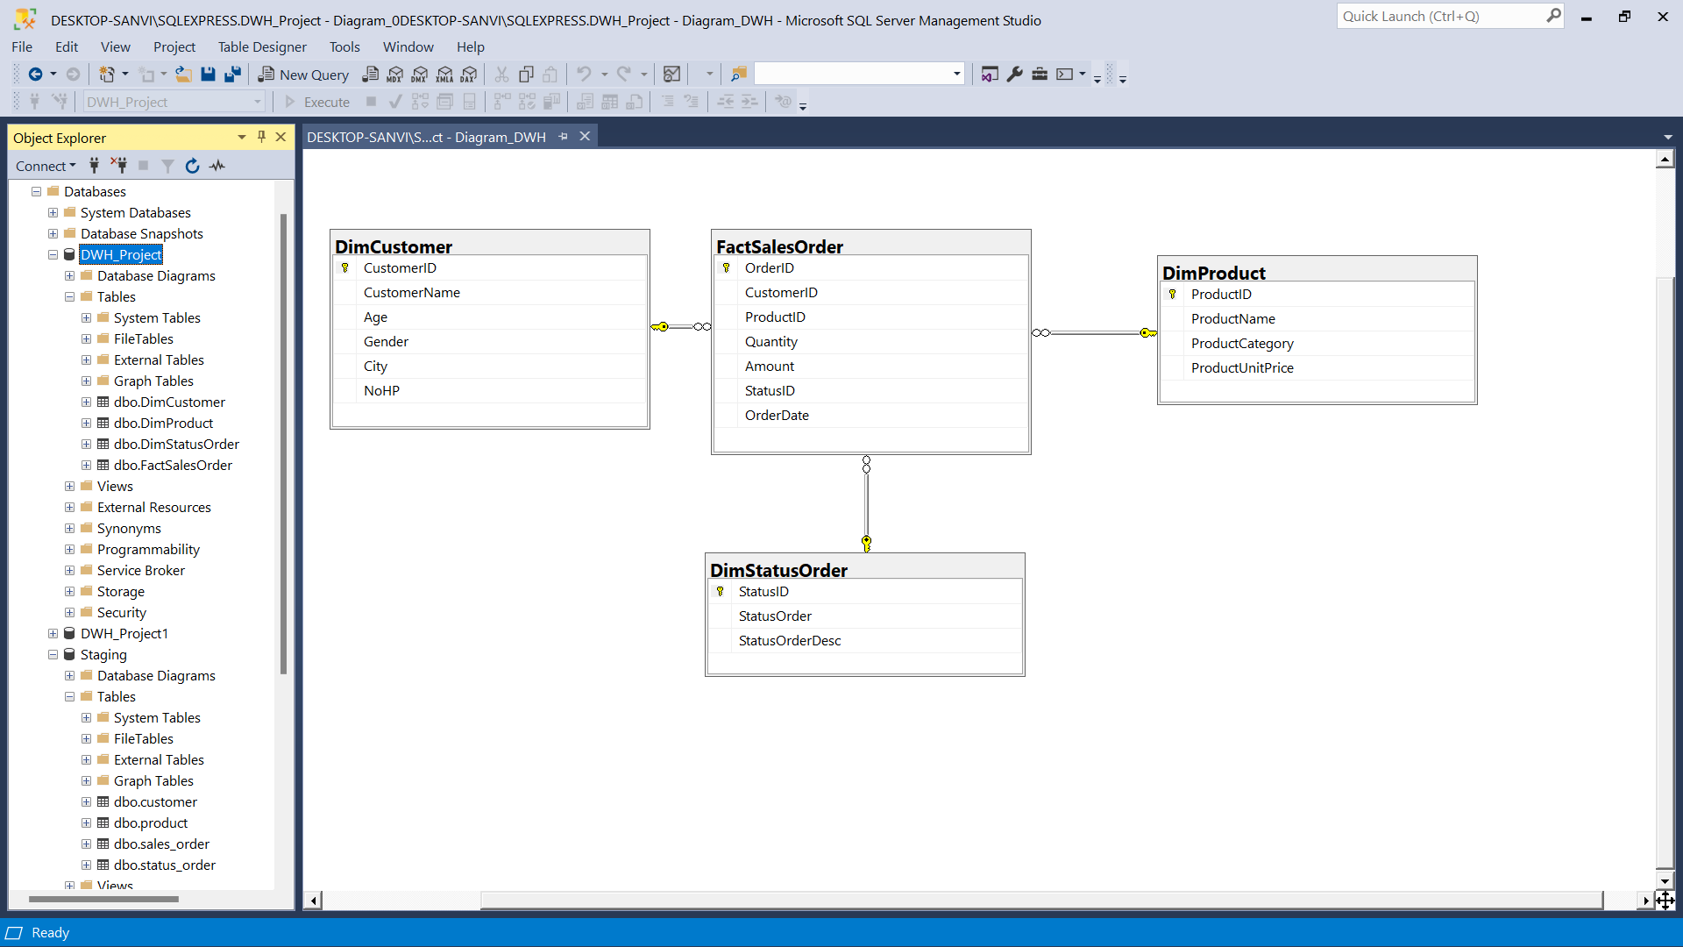
2) Create a Database named DWH_Project, as well create Fact and Dimension Tables from existing tables in staging database

Slide 9
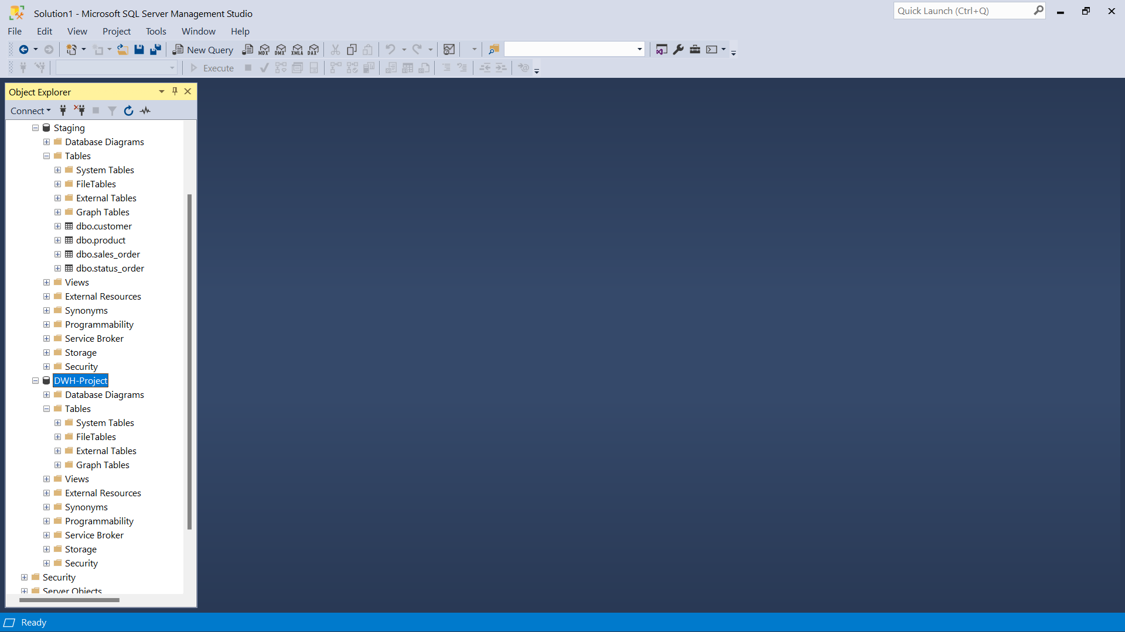
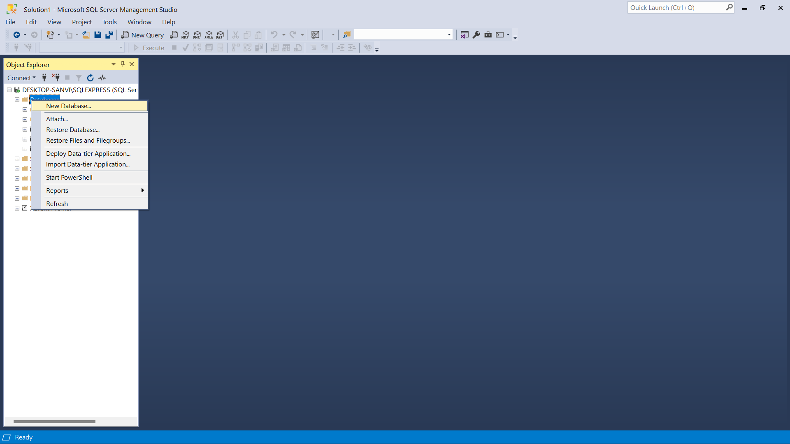
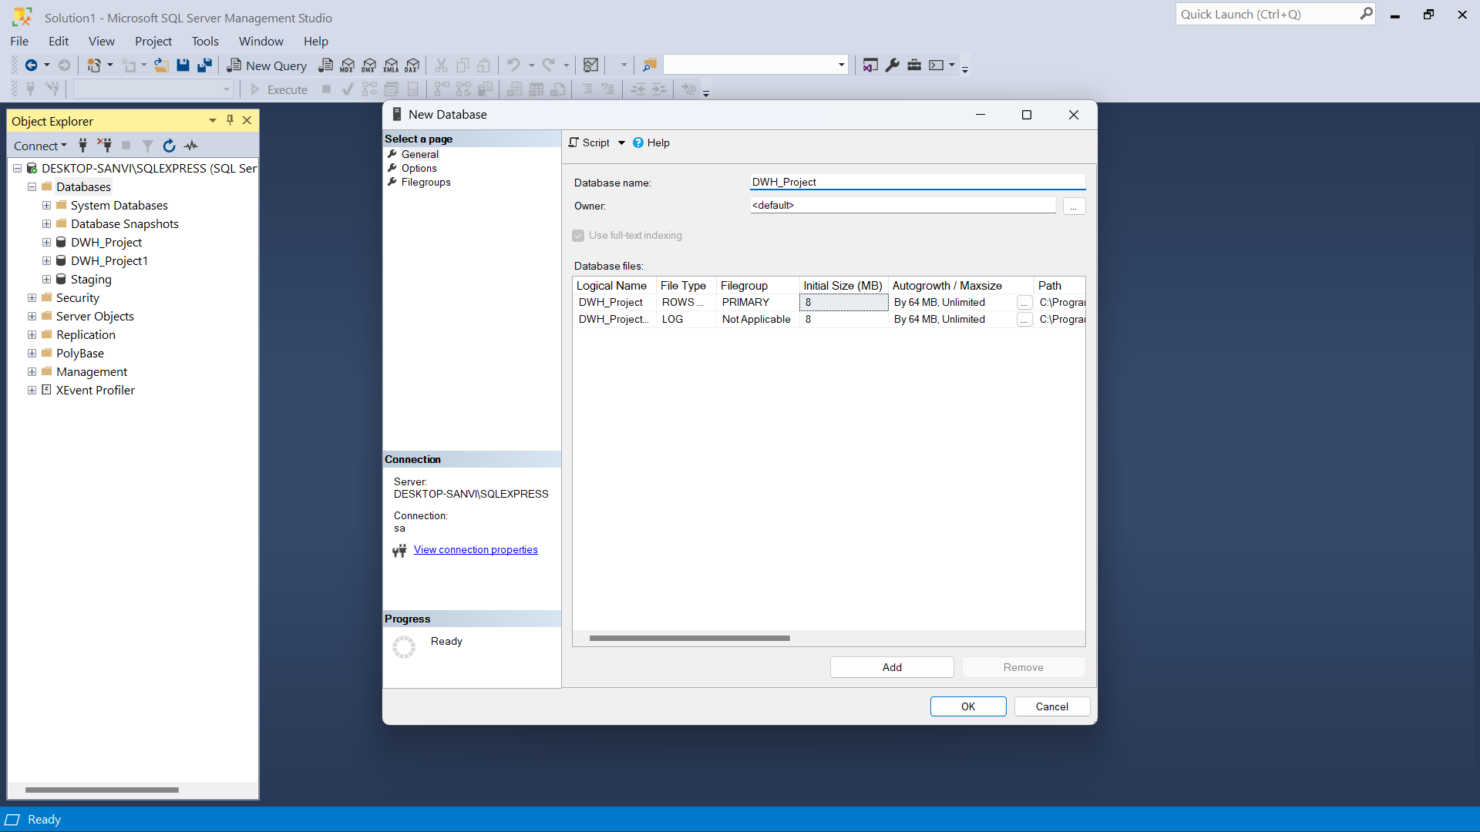
2) Create a Database named DWH_Project, as well create Fact and Dimension Tables from existing tables in staging database

Slide 10
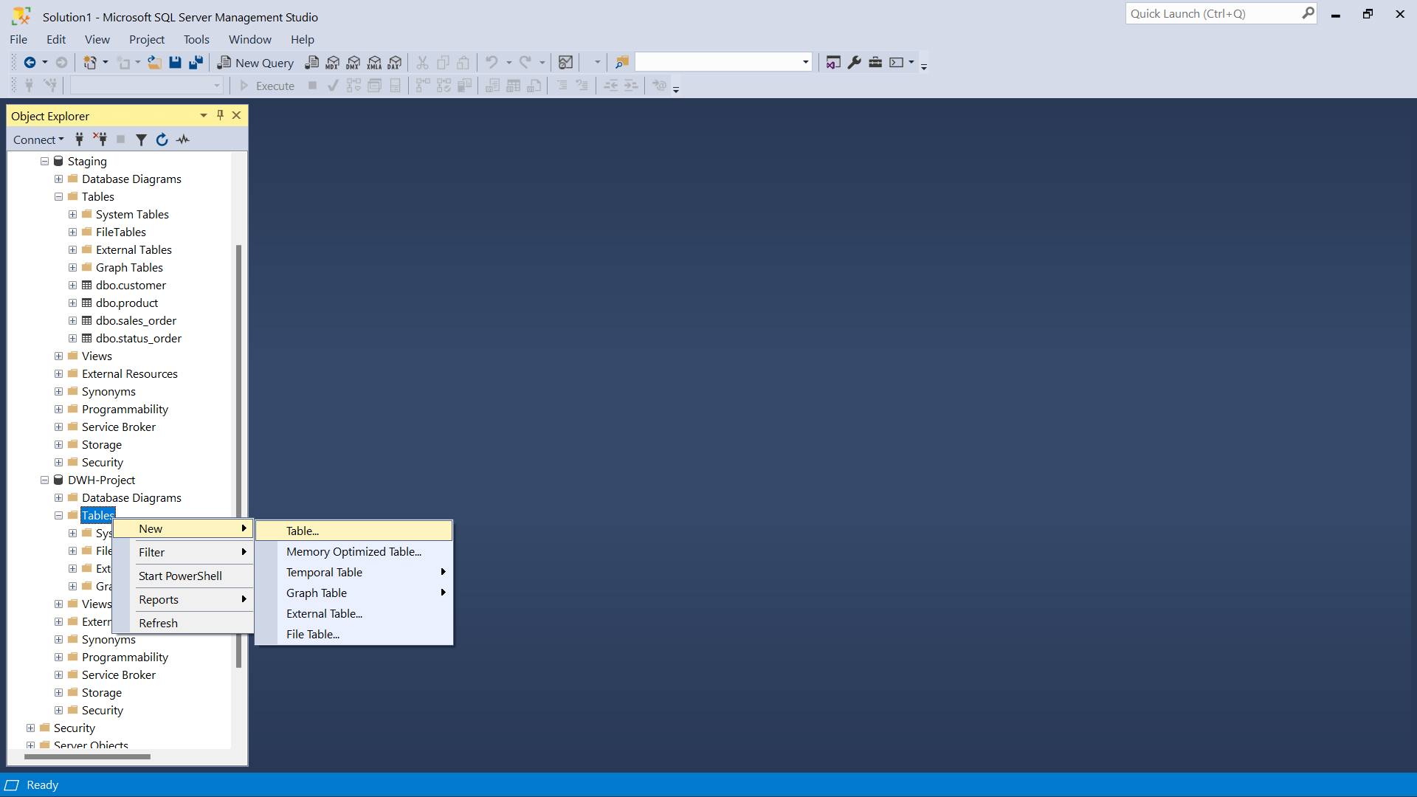
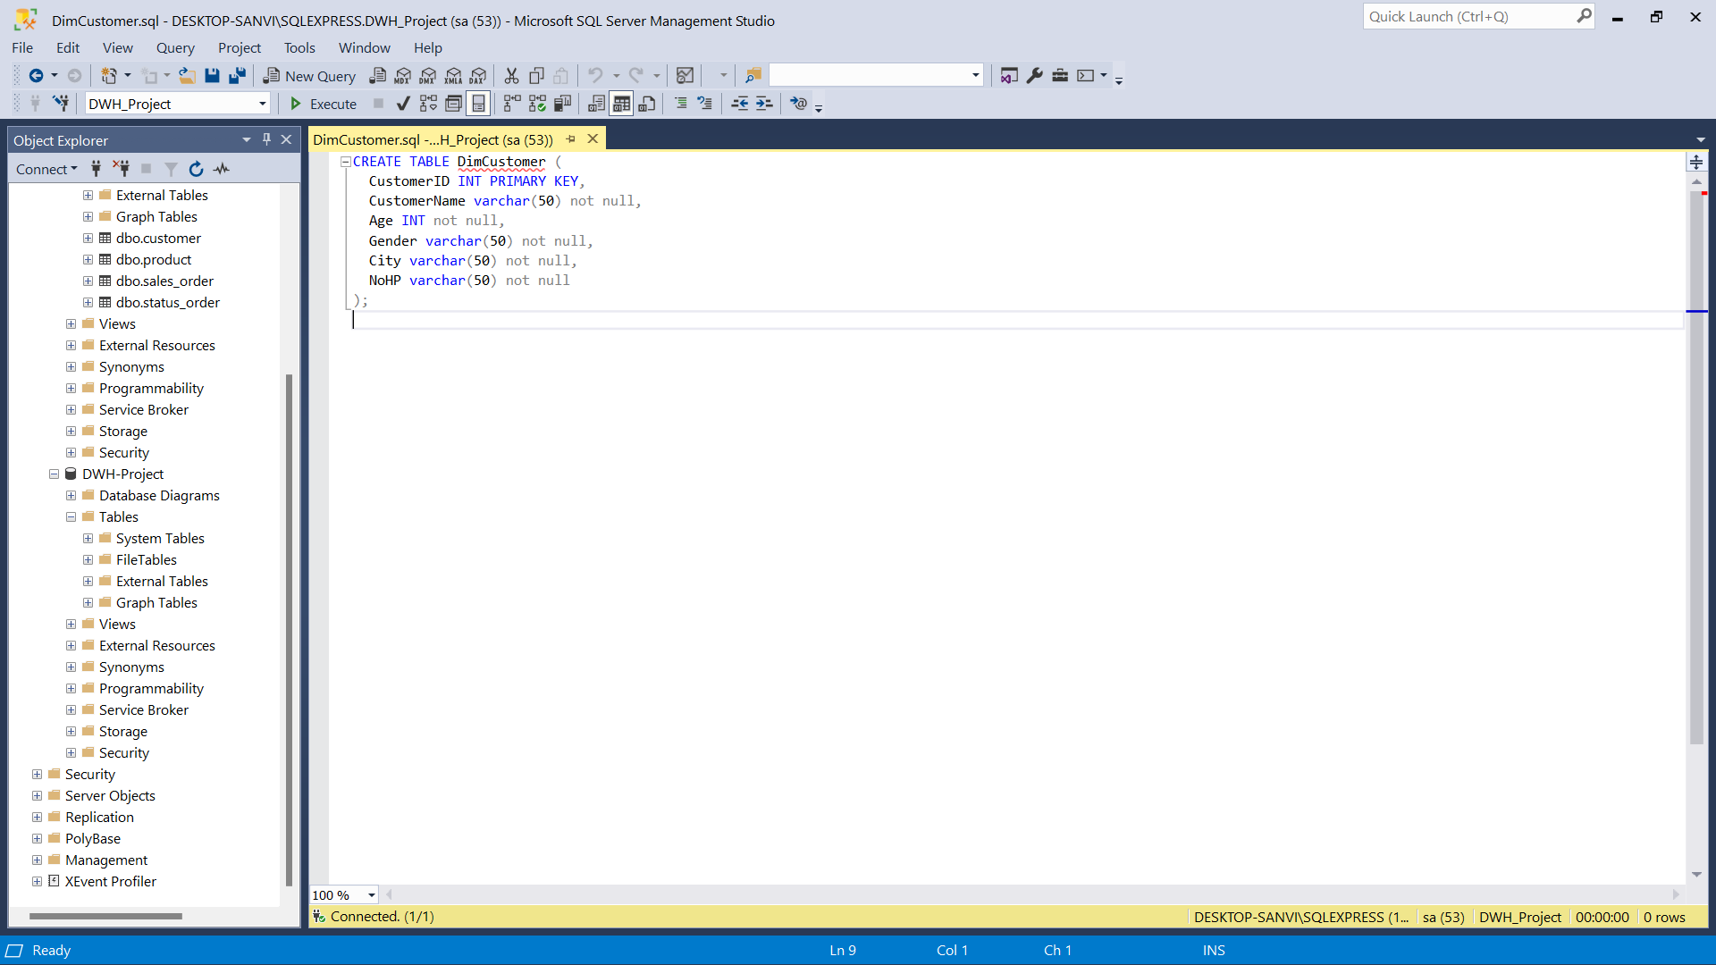
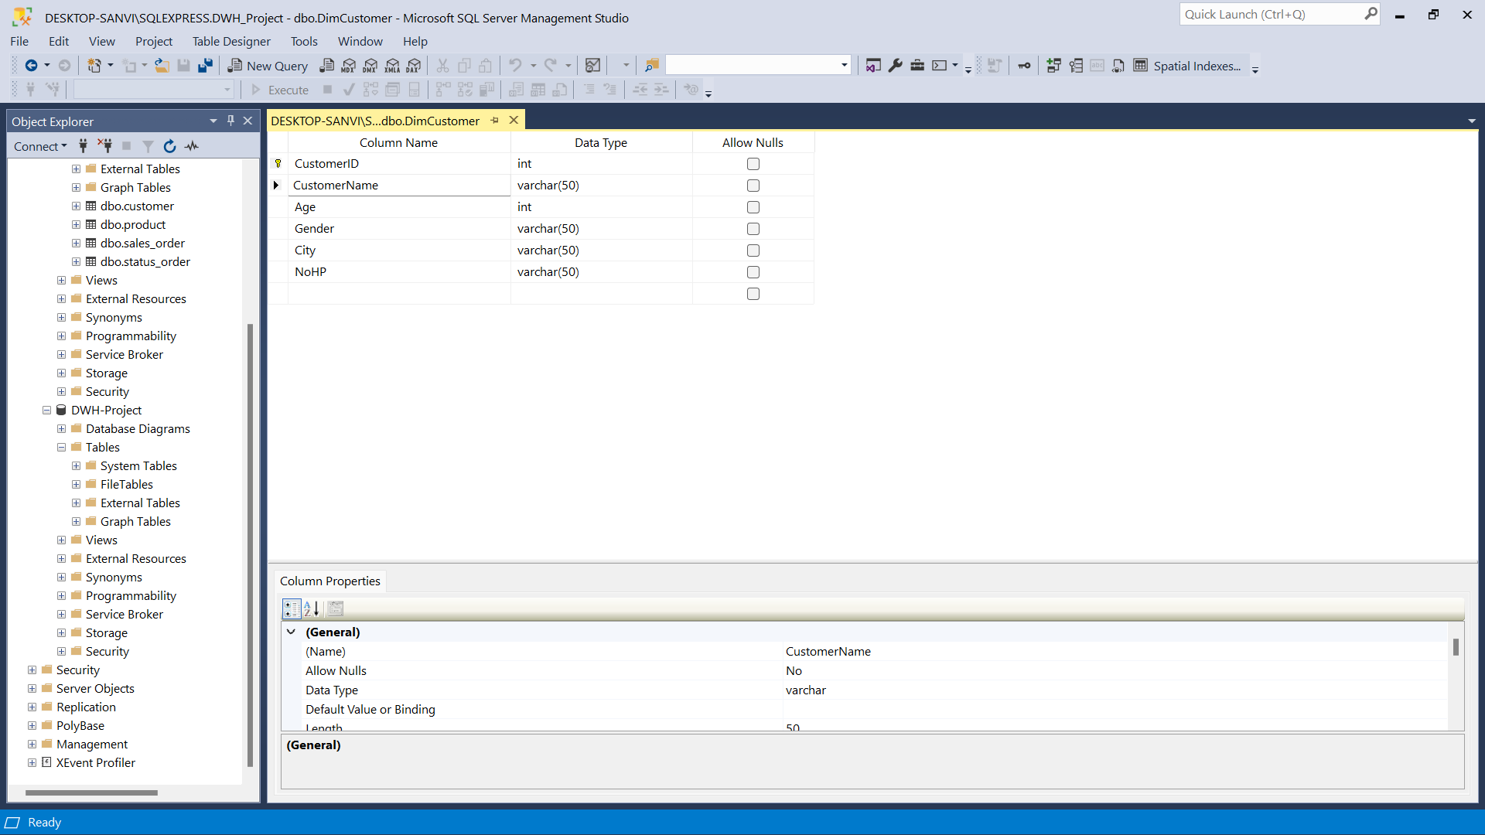
2) Create a Database named DWH_Project, as well create Fact and Dimension Tables from existing tables in staging database

Slide 11
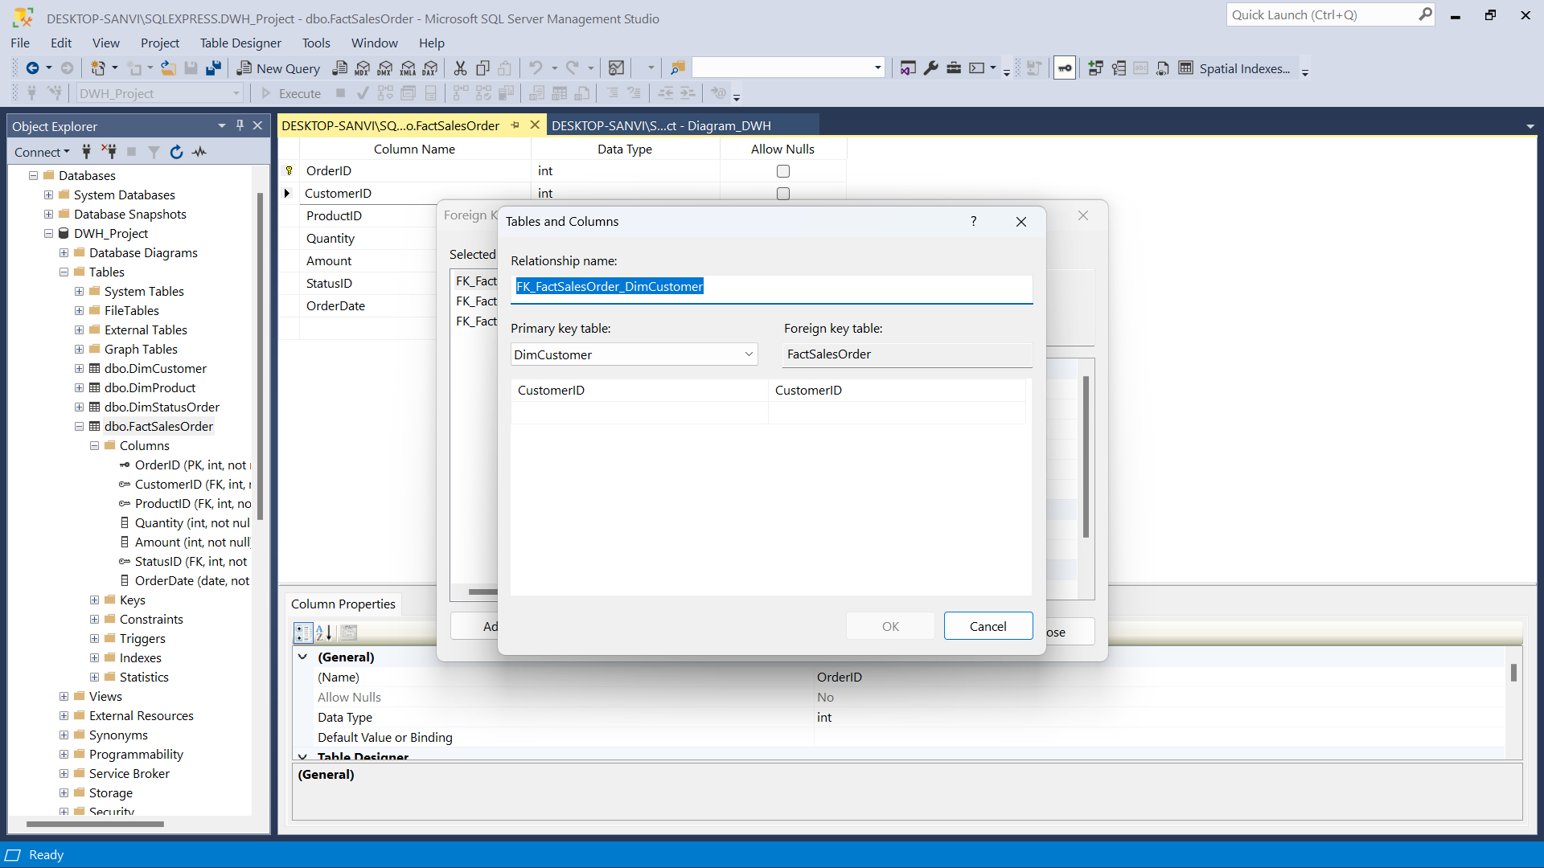
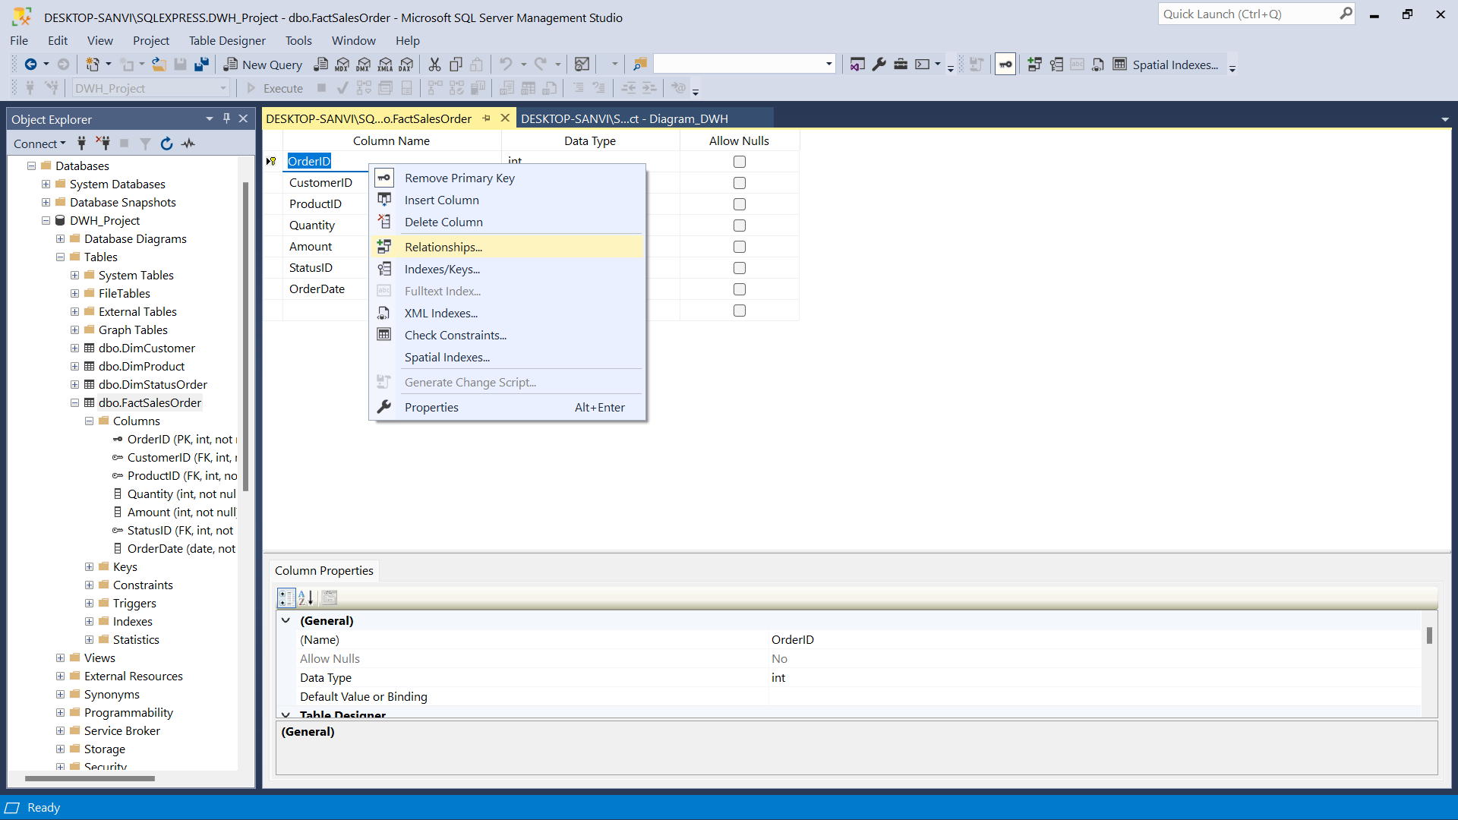
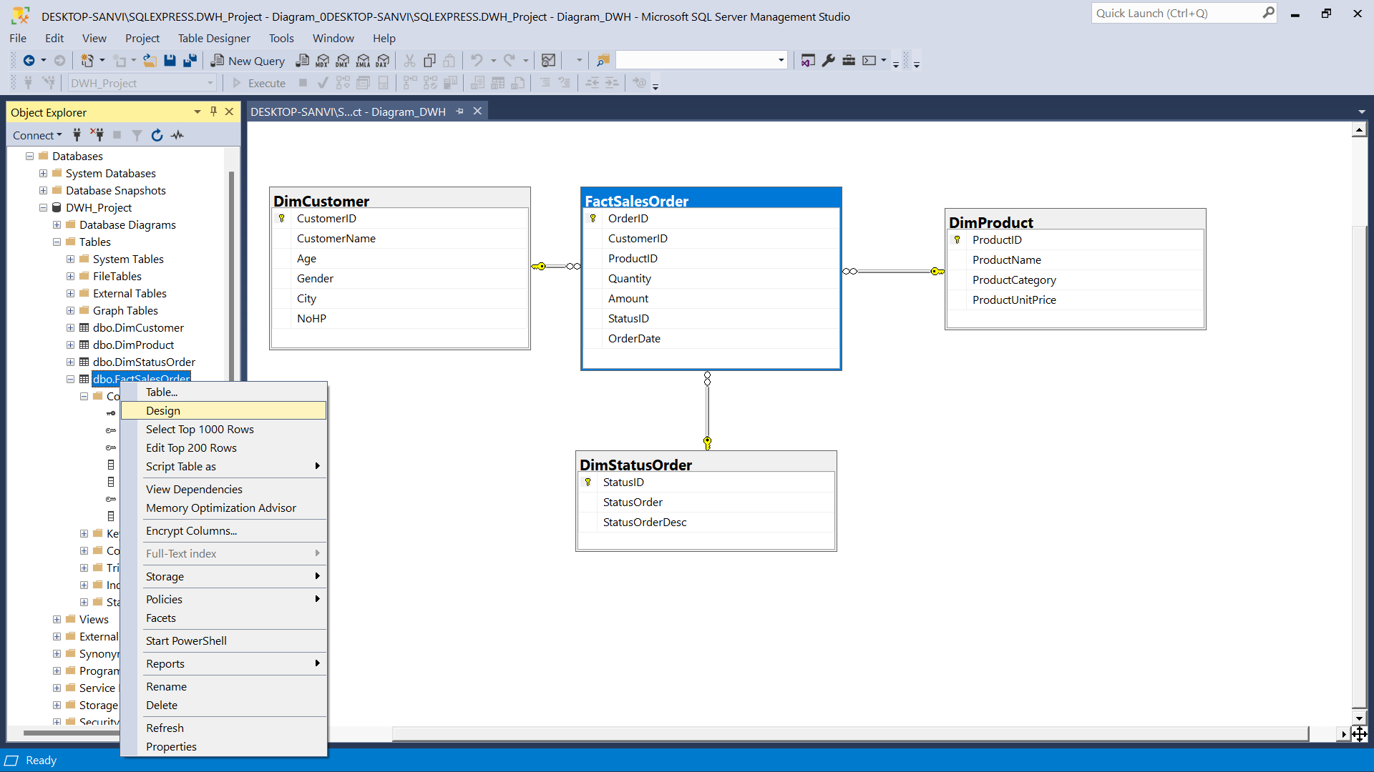
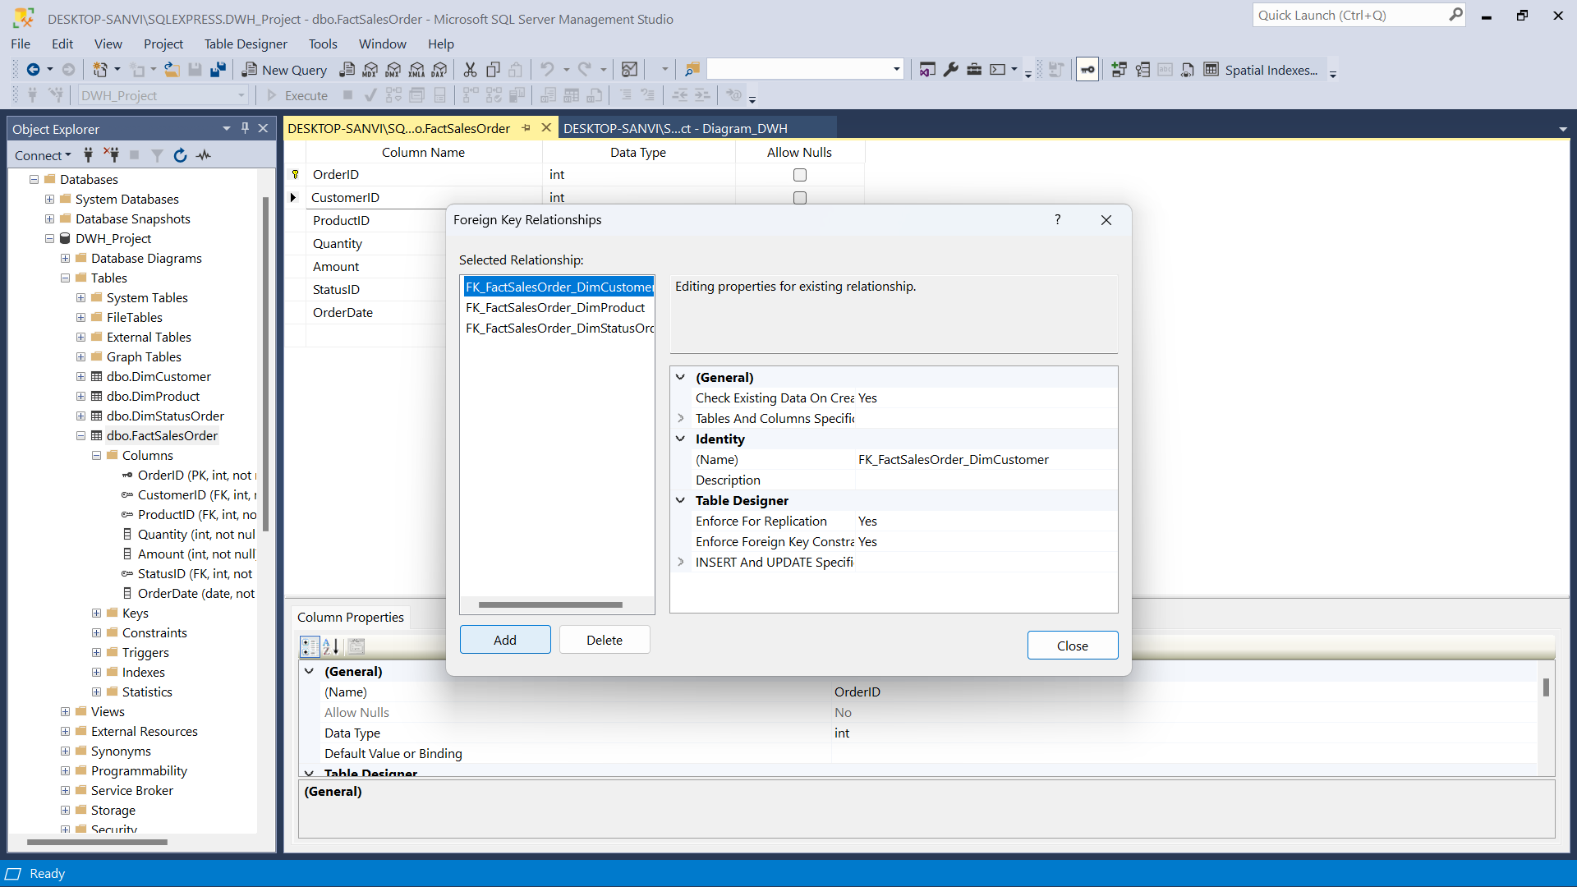
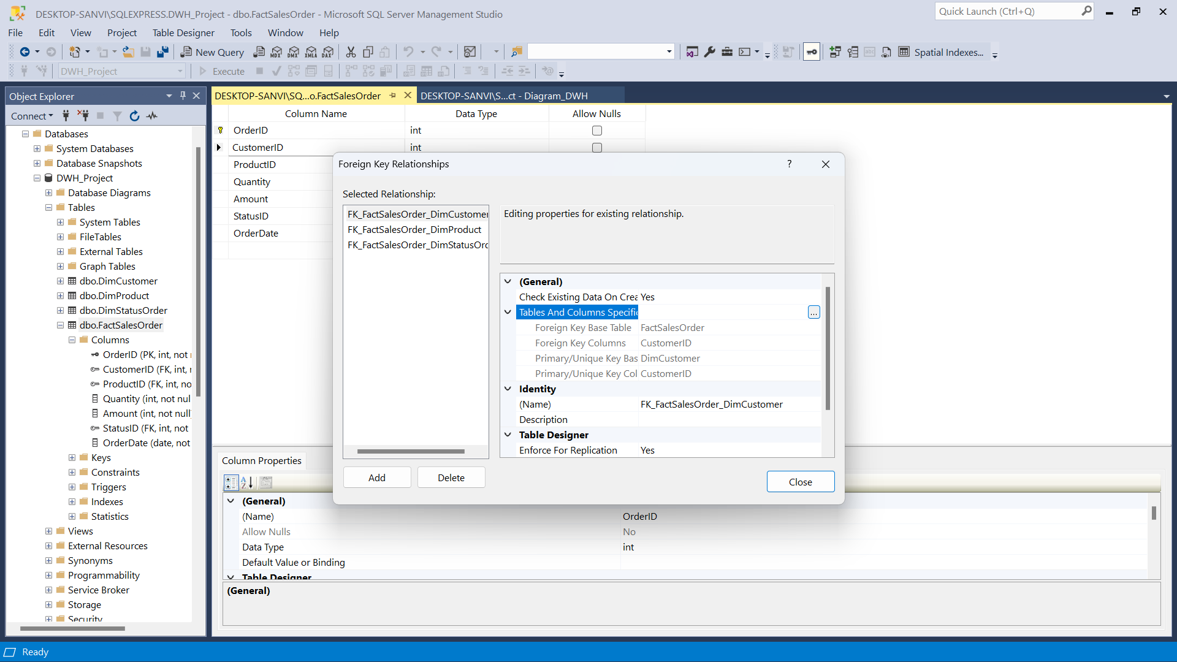
2) Create a Database named DWH_Project, as well create Fact and Dimension Tables from existing tables in staging database

Slide 12
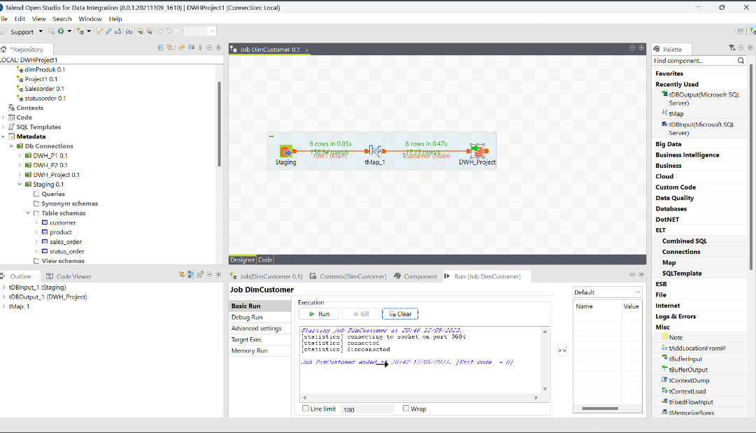
3) Create an ETL Job in the talend application to move data from Staging to Data Warehouse

Slide 13
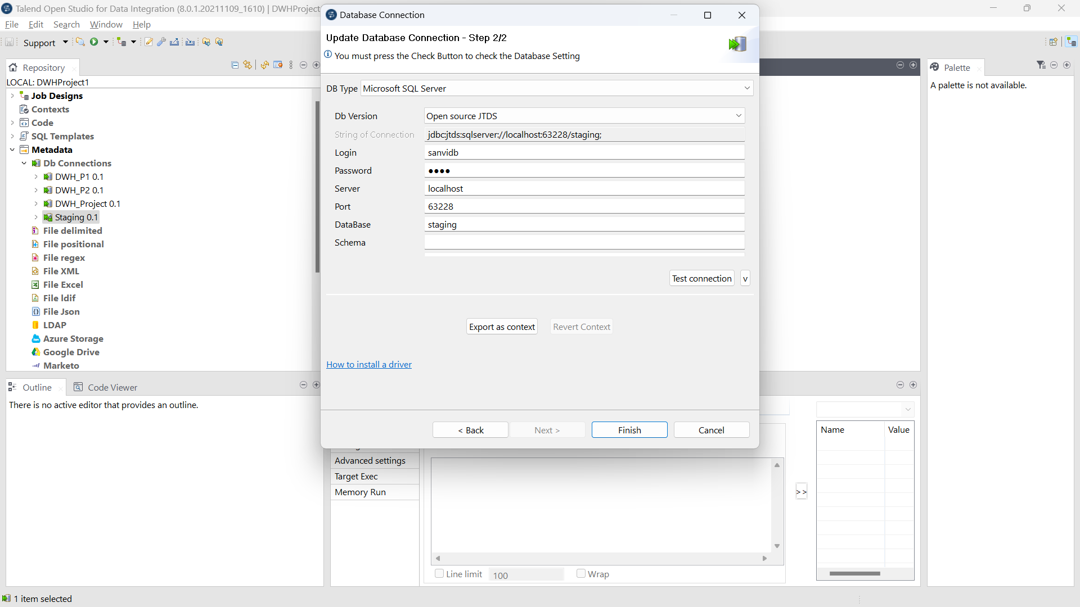
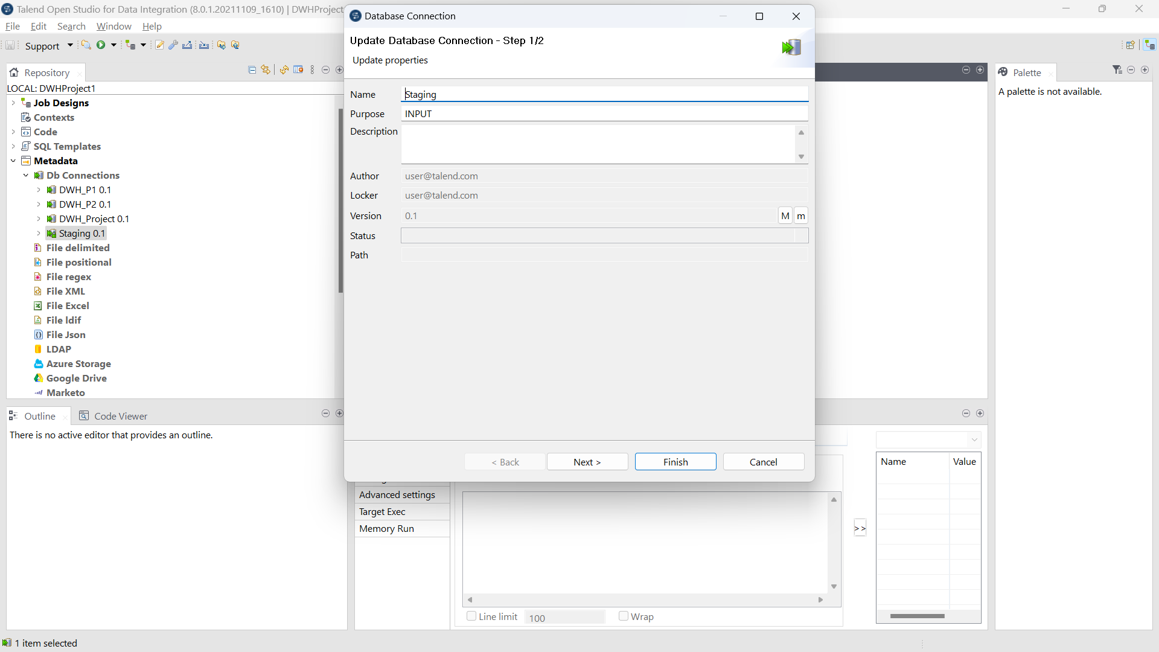
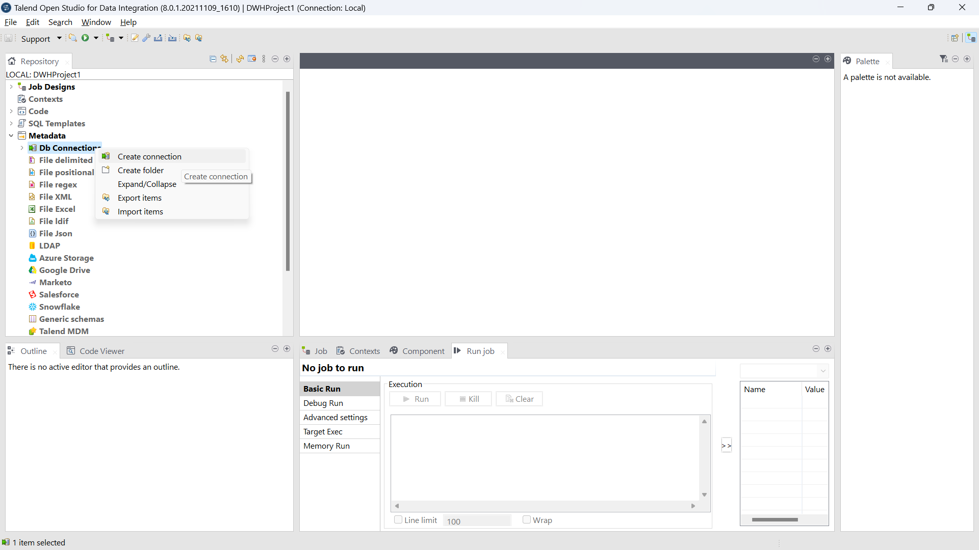
3) Create an ETL Job in the talend application to move data from Staging to Data Warehouse

Slide 14
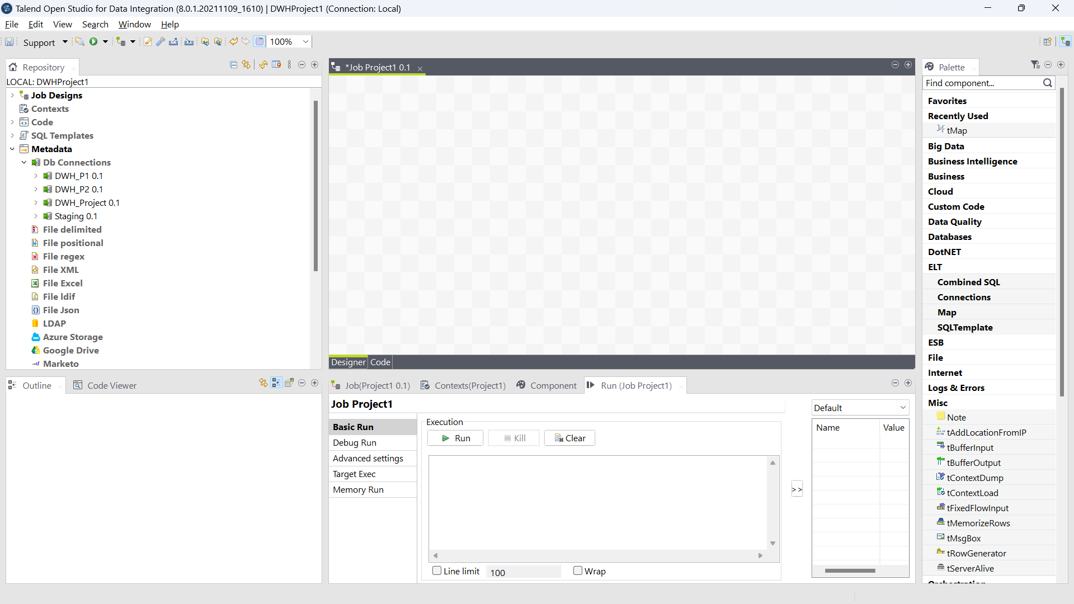
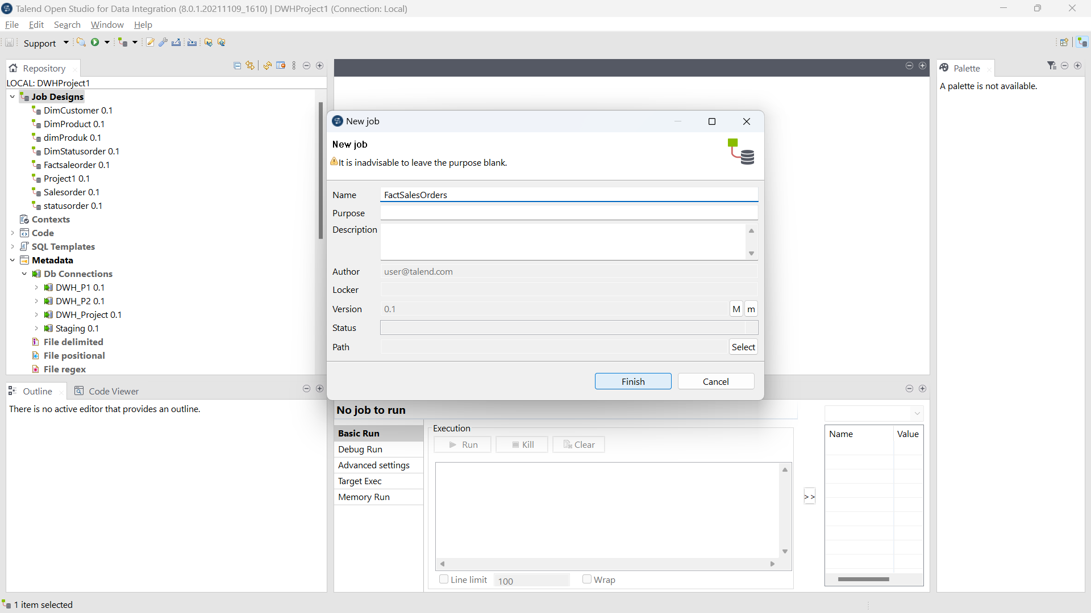
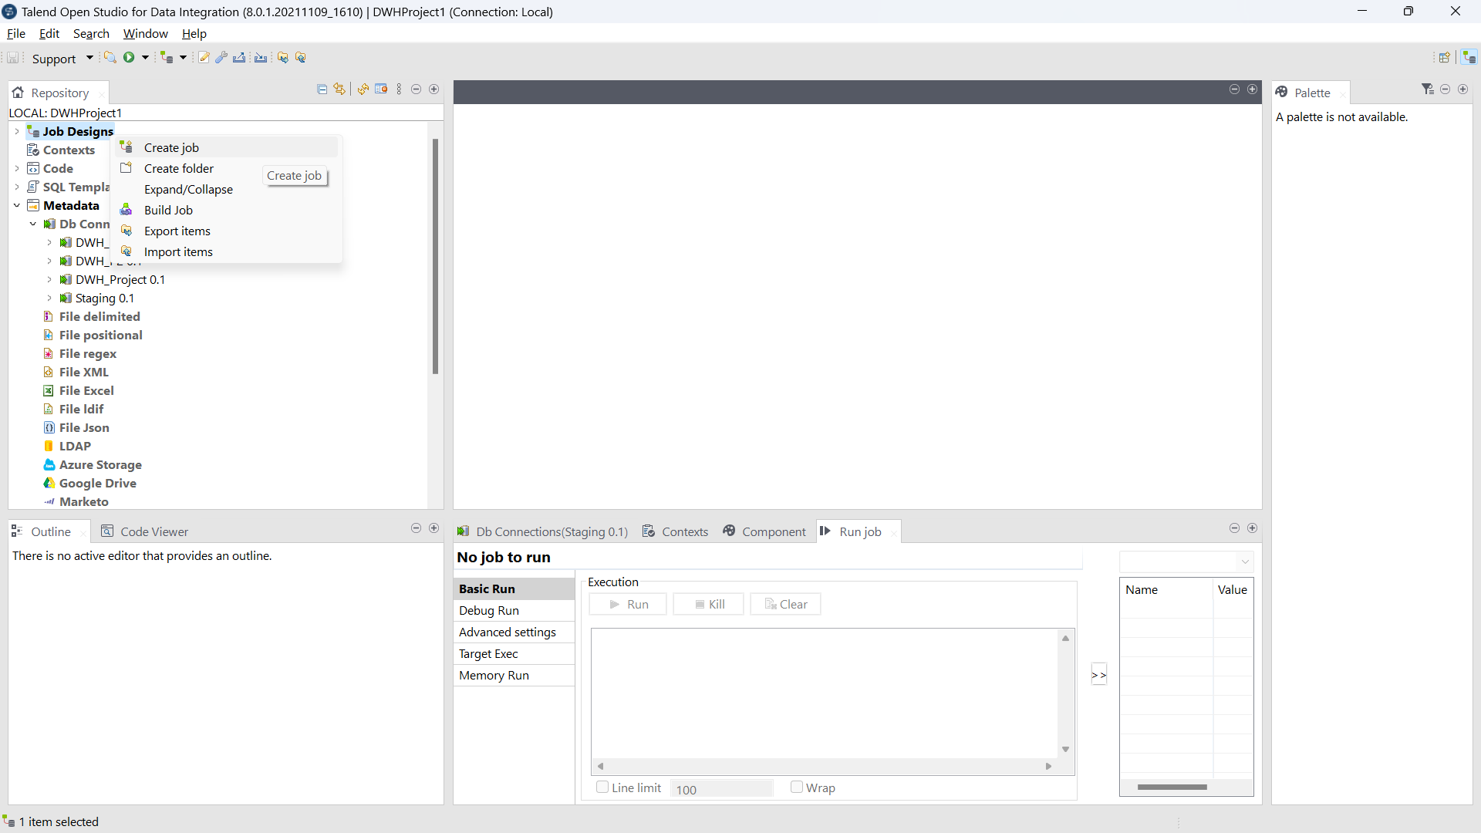
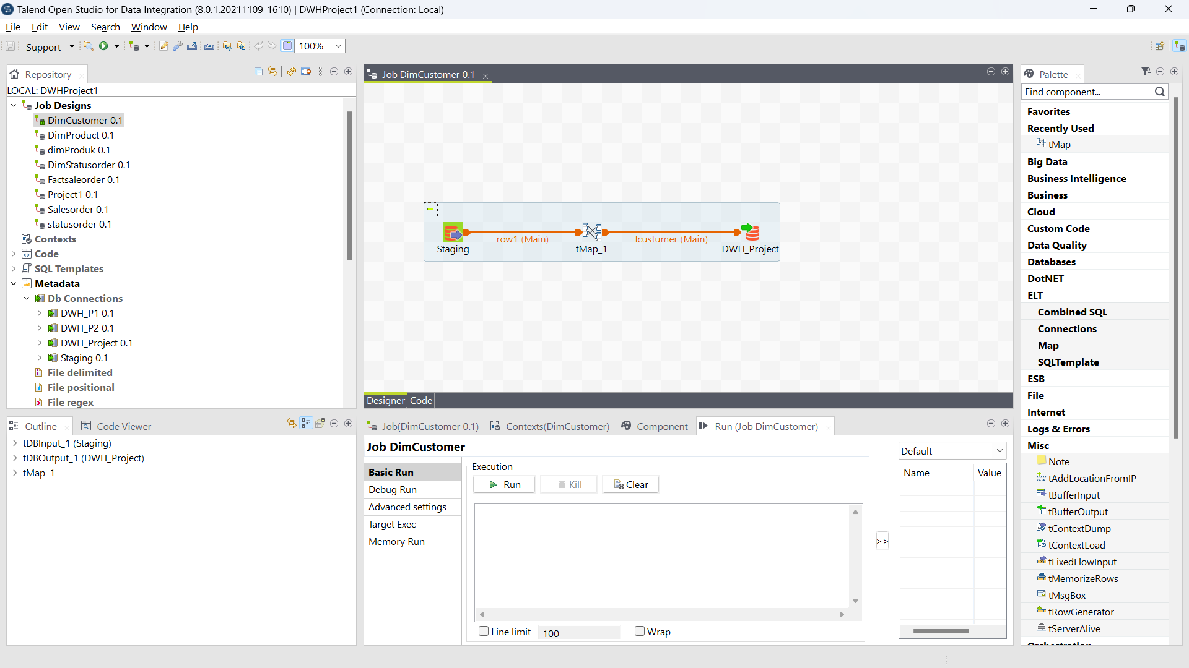
3) Create an ETL Job in the talend application to move data from Staging to Data Warehouse

Slide 15
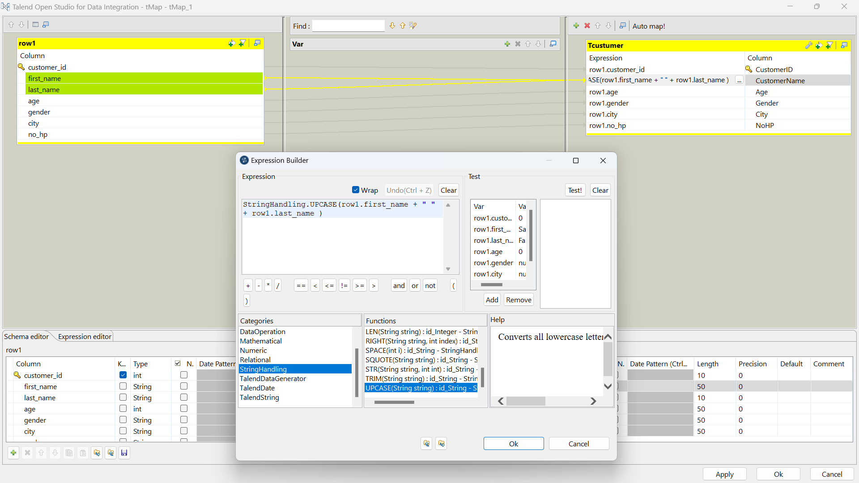
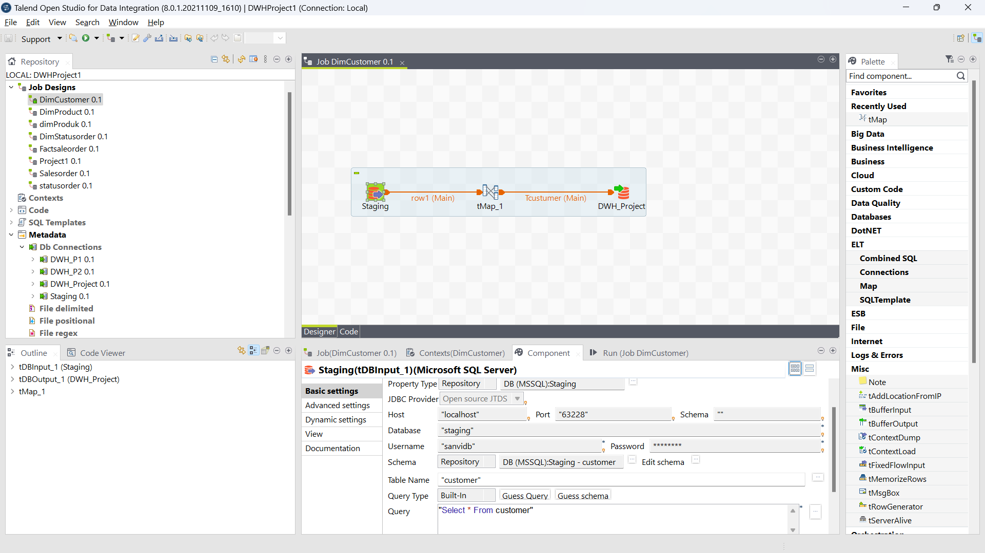
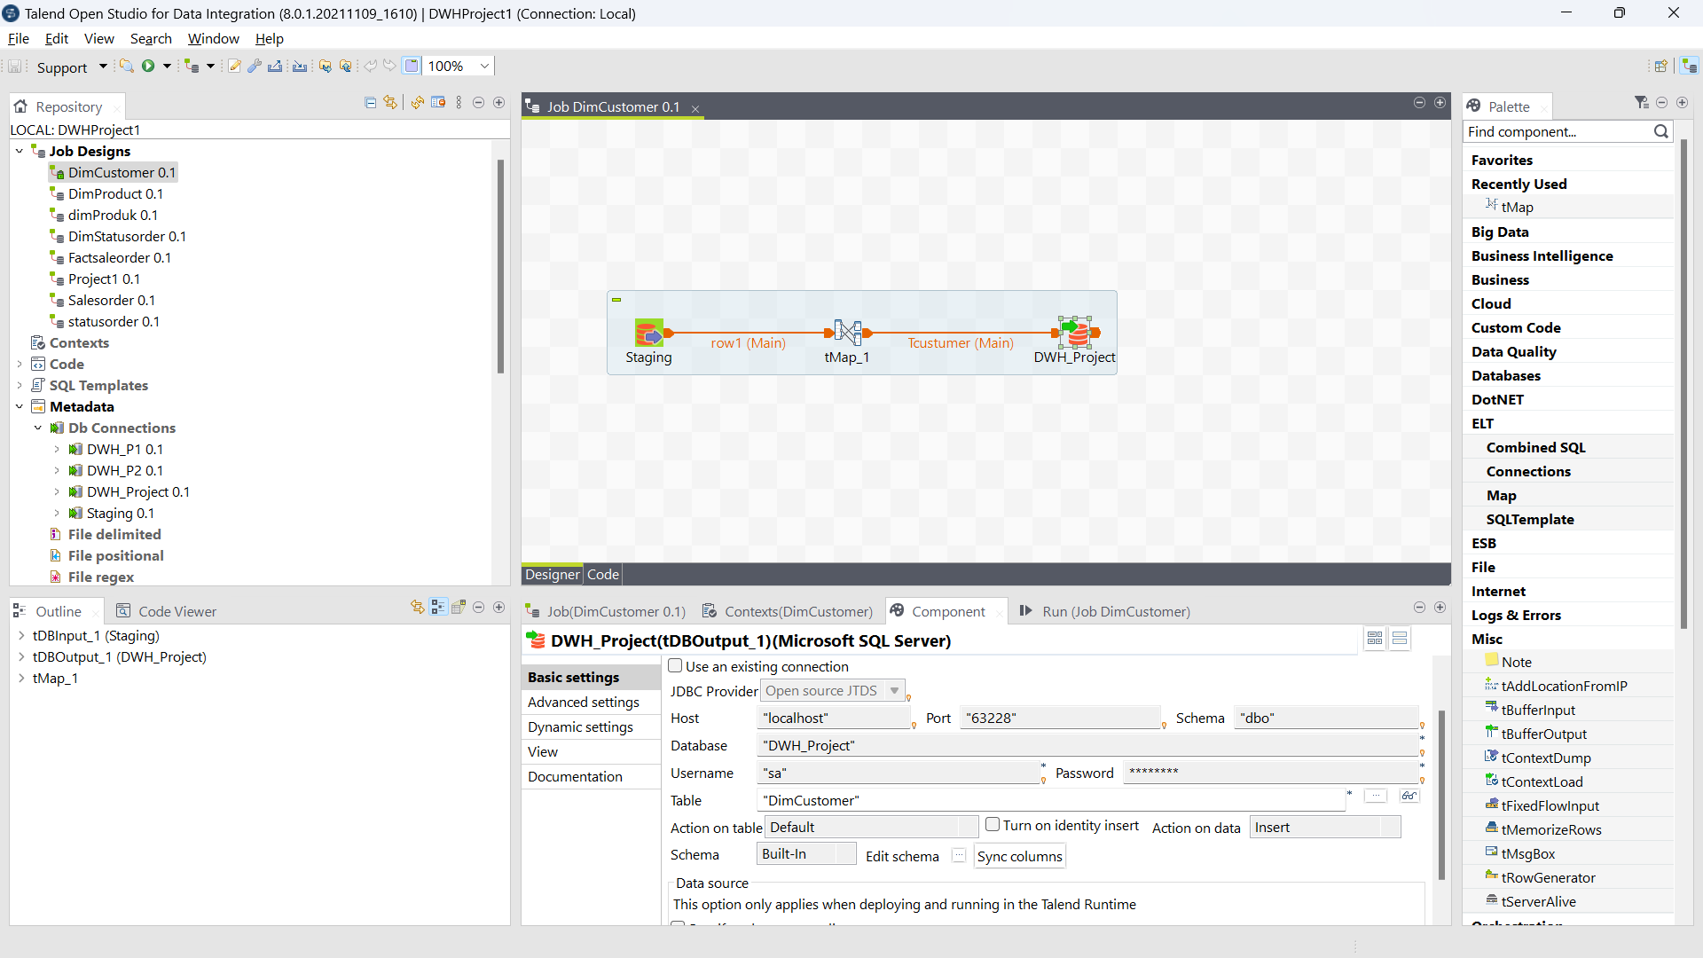
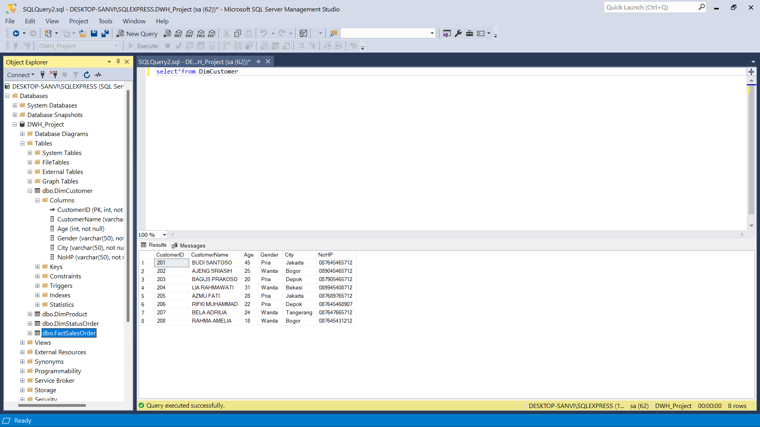
3) Create an ETL Job in the talend application to move data from Staging to Data Warehouse

Slide 16
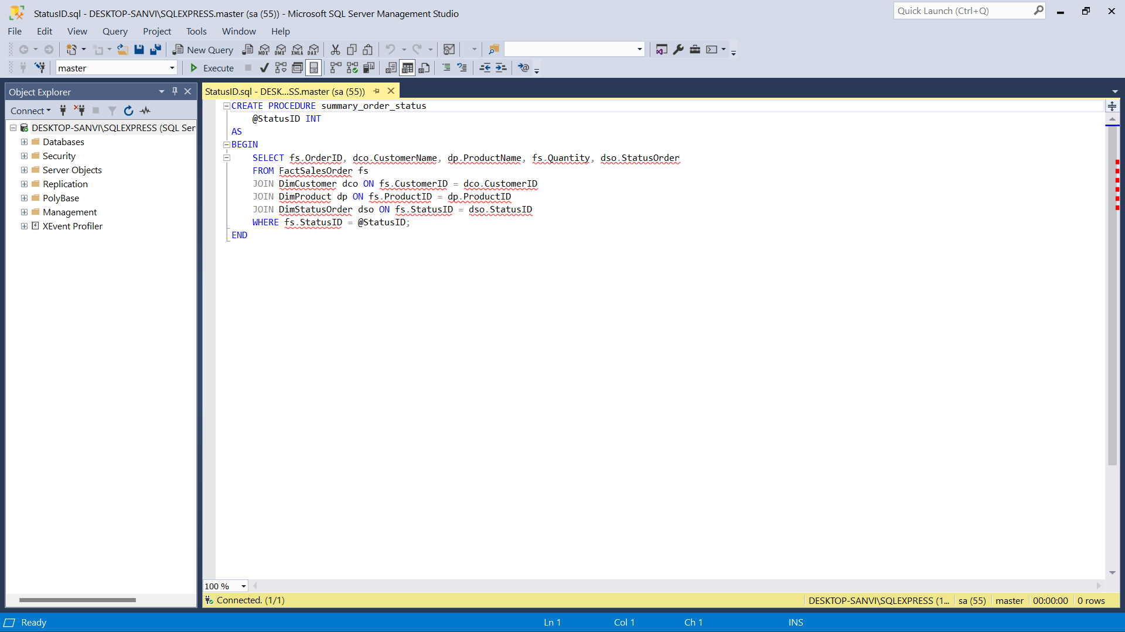
4) Create a Store Procedure (SP) to display summary sales order based on delivery status.

Slide 17
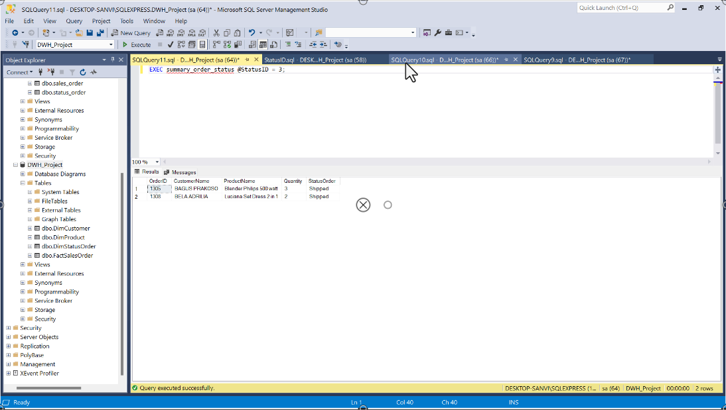
4) Create a Store Procedure (SP) to display summary sales order based on delivery status.

Slide 18

Insert Your Link Github Here
https://github.com/sanvif-dot/FinalTask_IDX-Partners_DE

Slide 19
Video Presentation Here
https://drive.google.com/file/d/1Q5r06amkF1qs_qZtj7fkJm_YLMGonKIC/view?usp=share_link

Slide 20
Thank You
X
Logo Company

